Slide 1
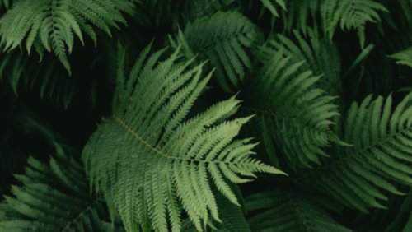
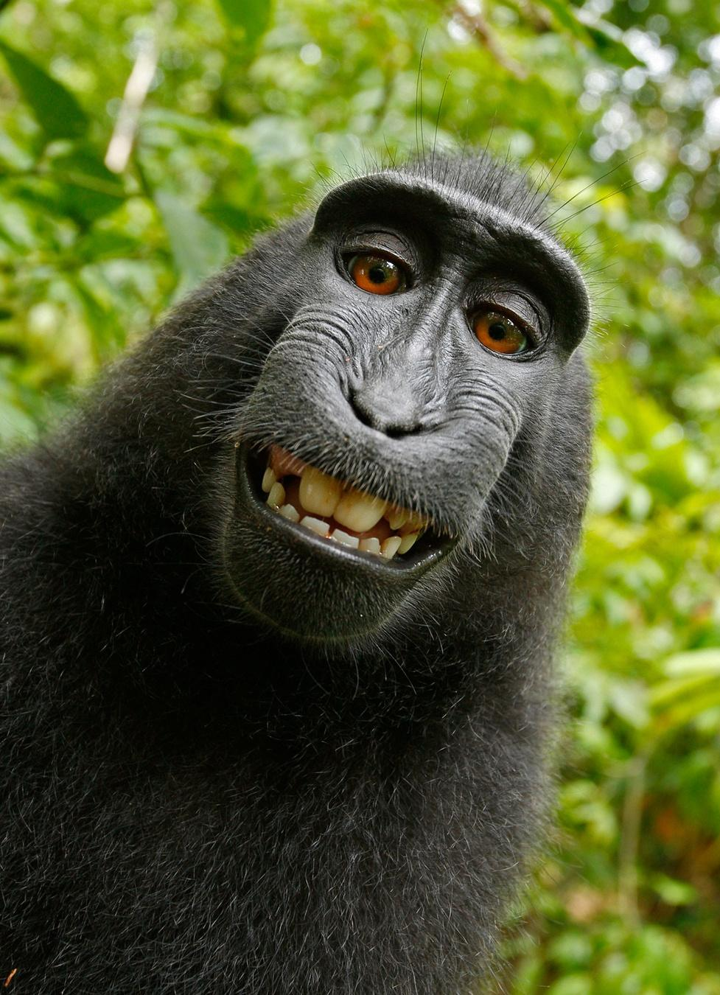
AI Safari Sentinel
Animal Detection and Clasification
AI Mini-Project

Slide 2
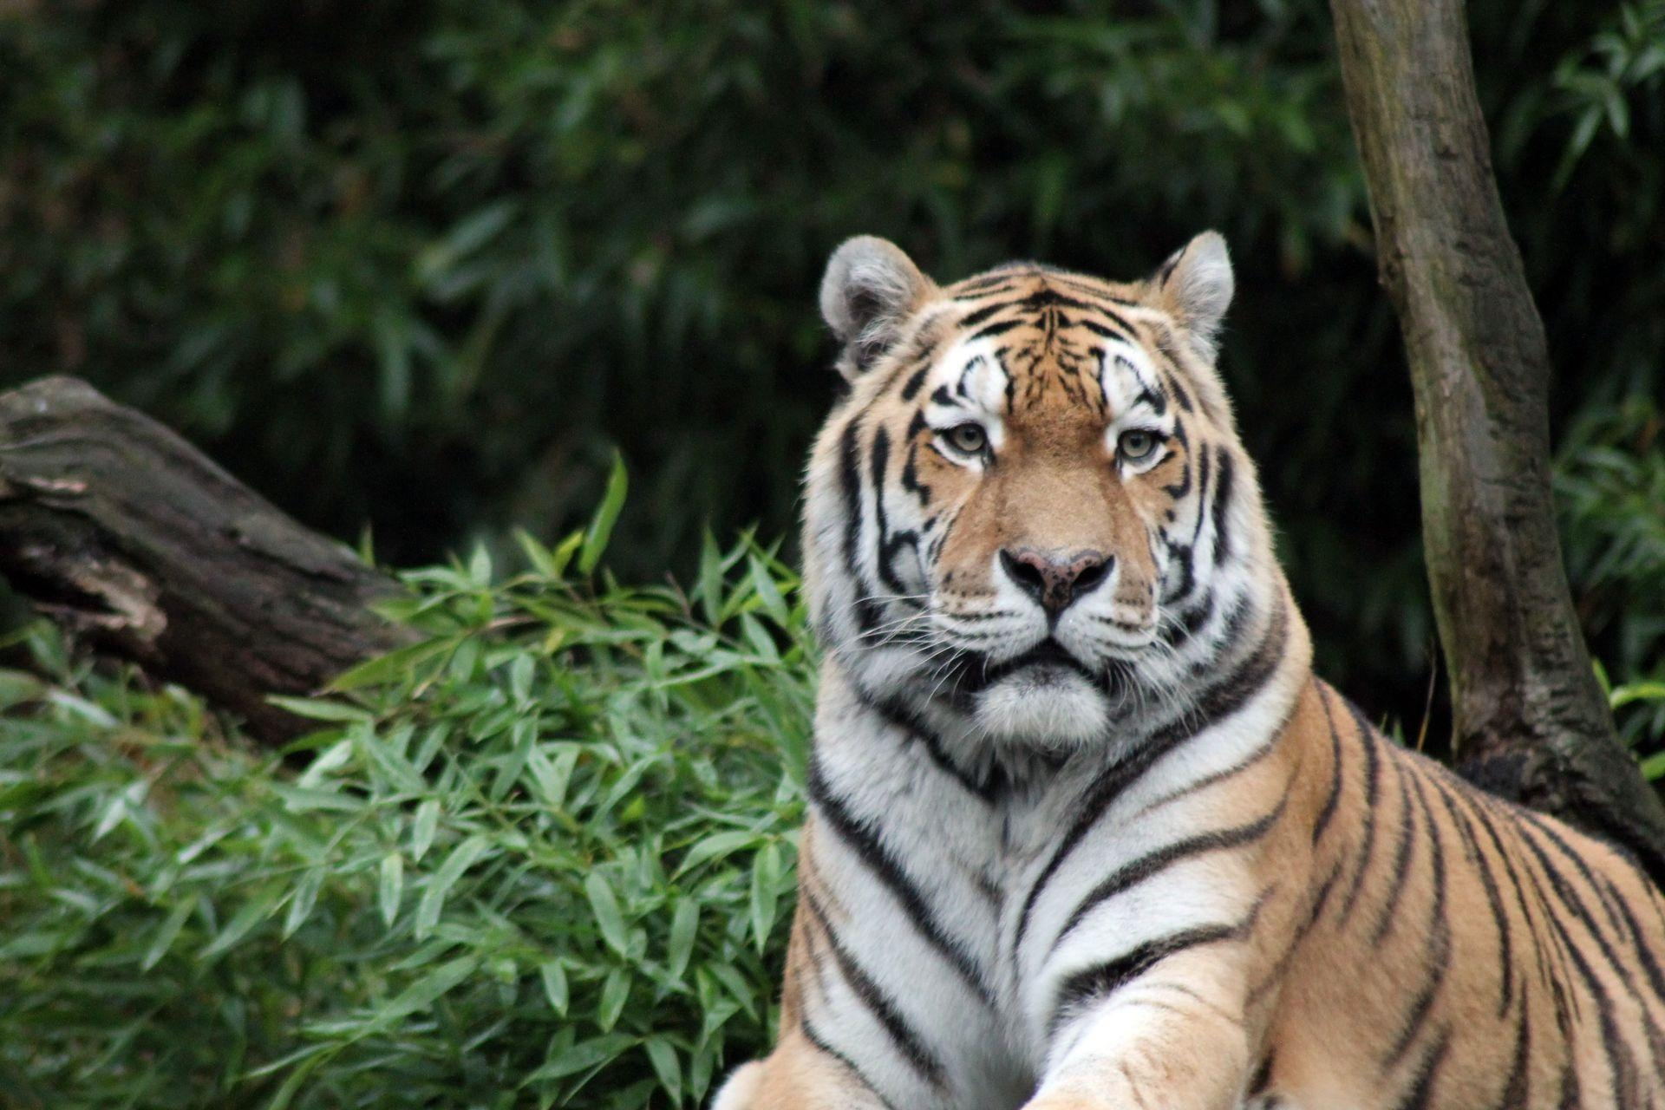
Agenda
1.
Identified Problem
2.
Proposed Solution
3.
Algorithm Used
4.
Demonstration
5.
Conclusion

Slide 3
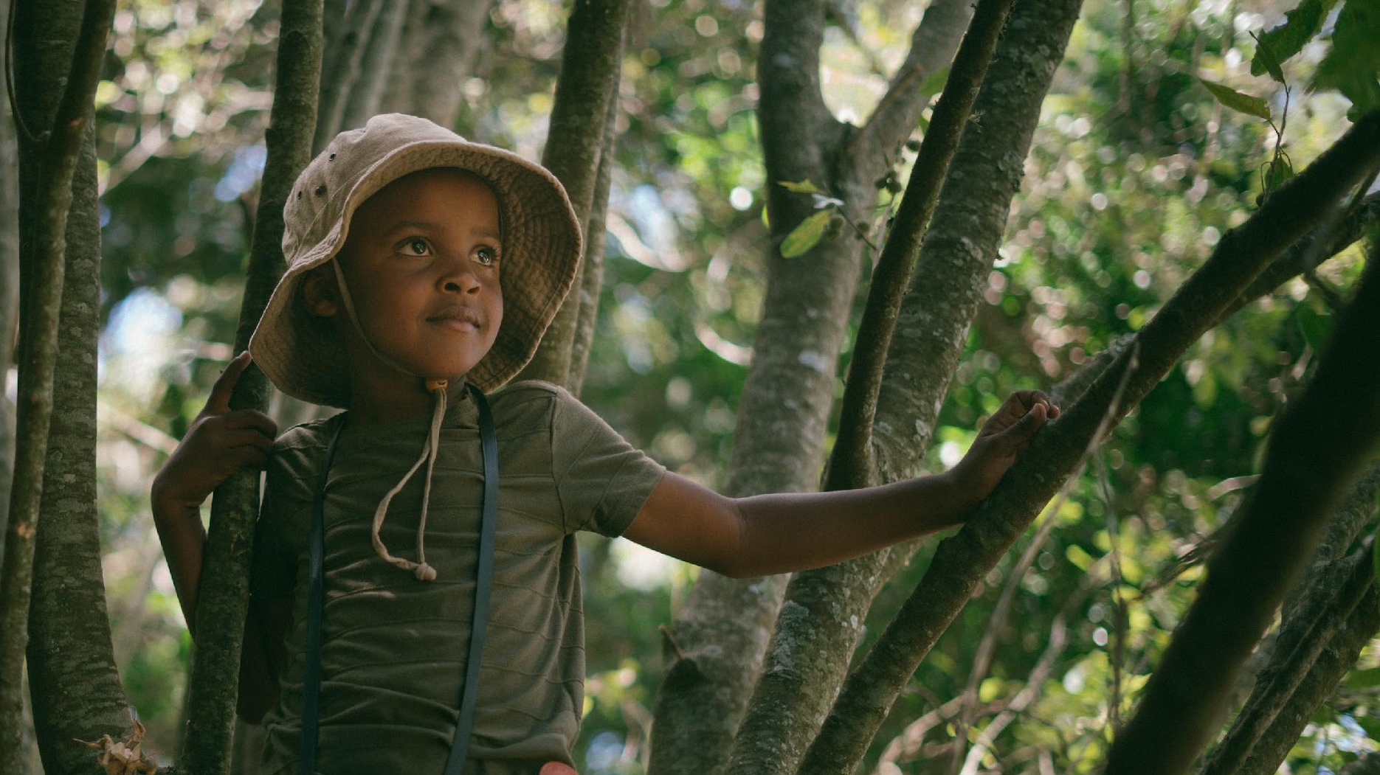
Problem Statement
In the realm of biodiversity research and conservation, the manual identification and classification of animal species are time-consuming, resource-intensive, and often prone to human error. The need for accurate and efficient methods for animal classification is necessary, especially as the global biodiversity crisis accelerates. Developing a robust AI-based animal classification system that can reliably and swiftly identify species from images or video is critical for advancing ecological research.

Slide 4
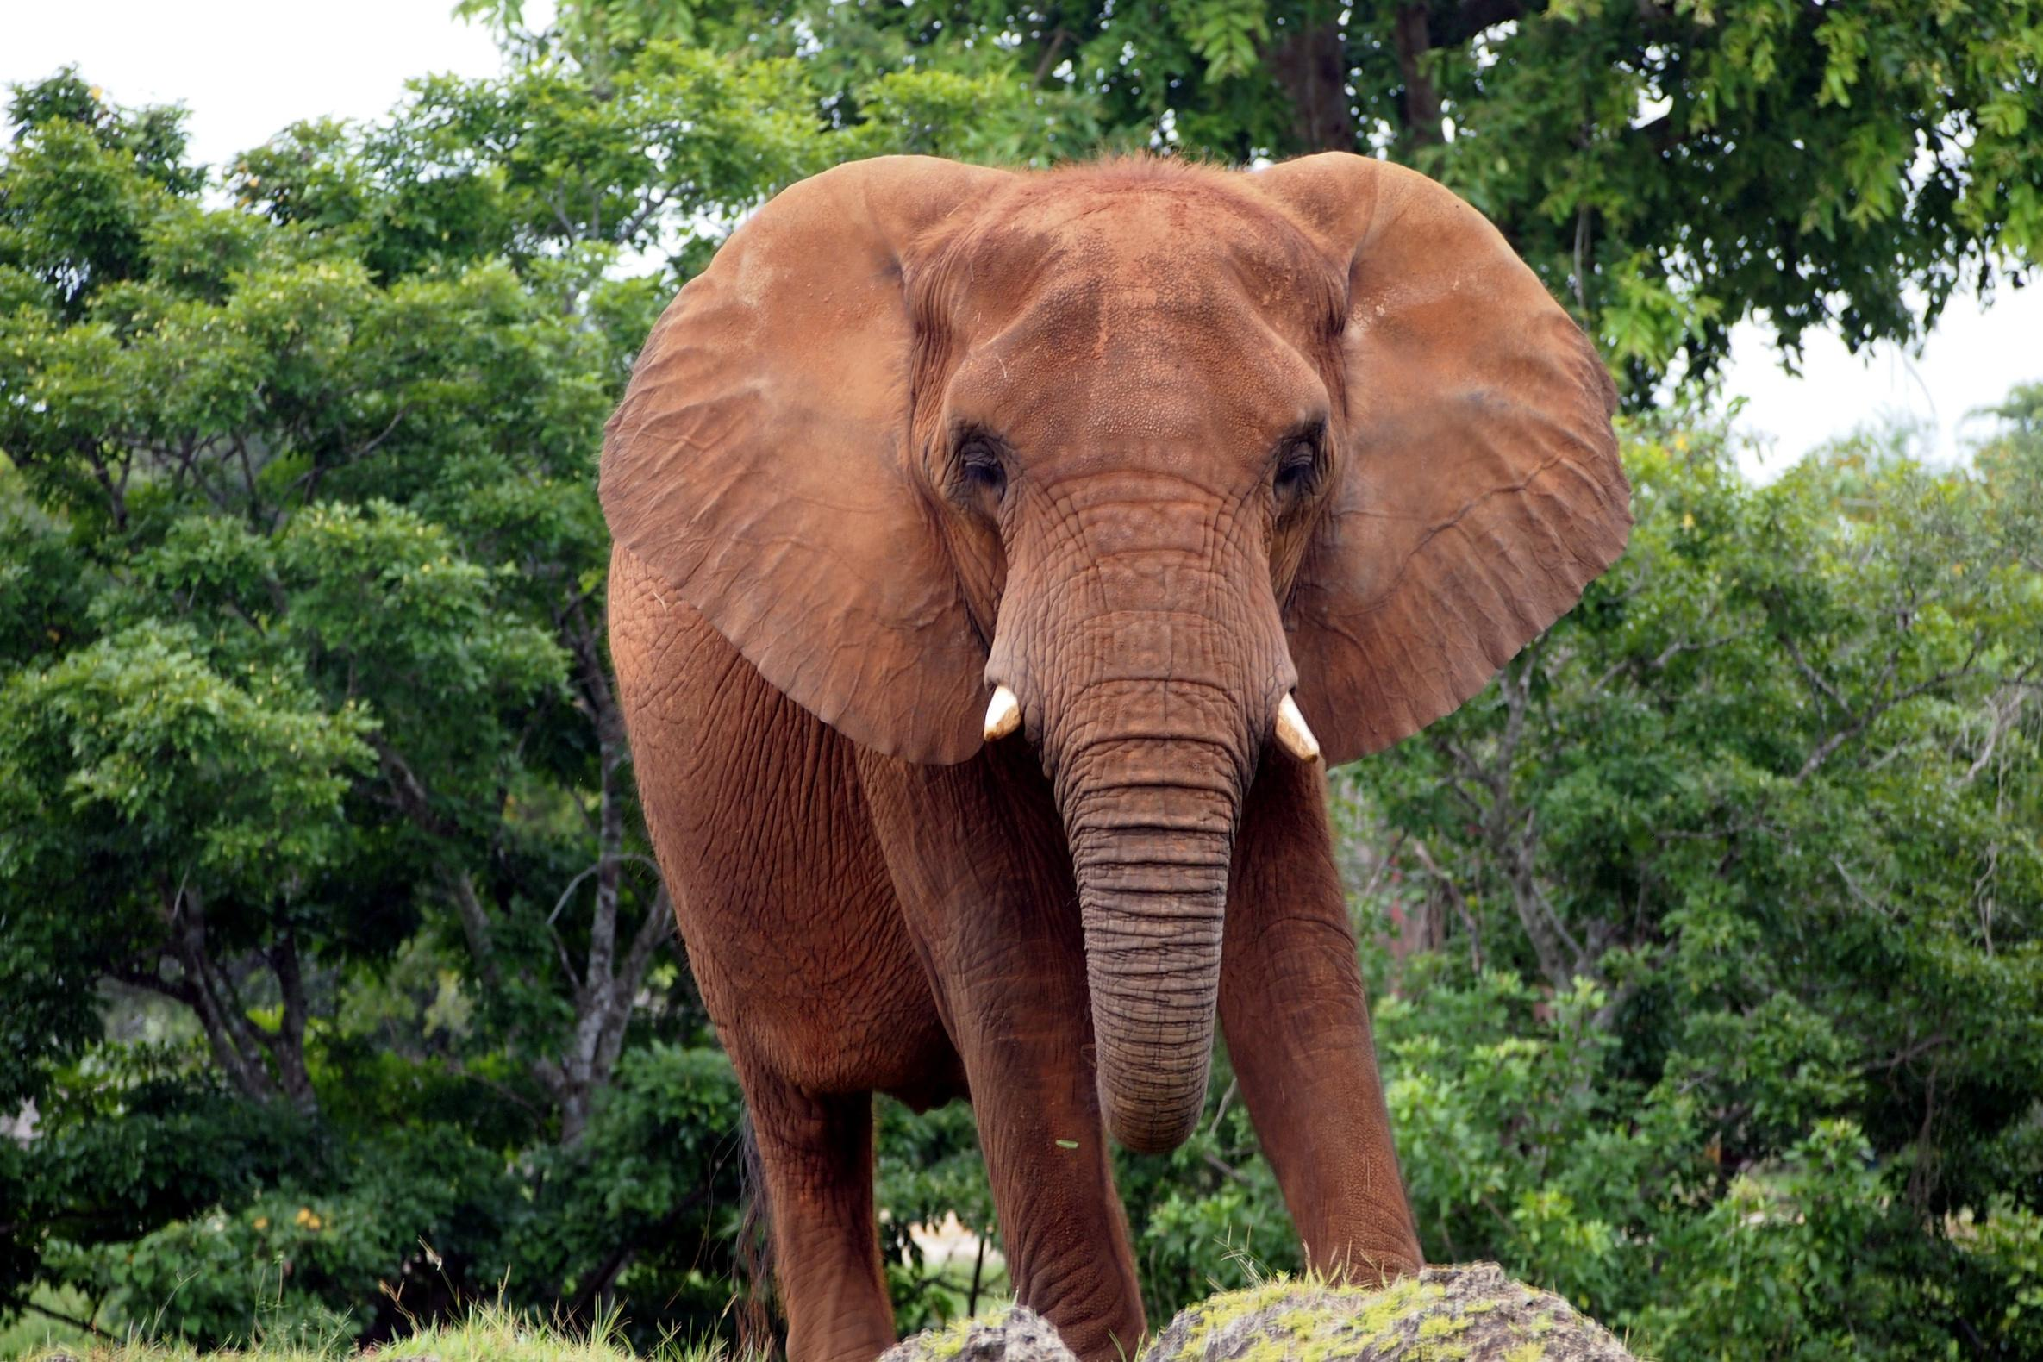
Our Solution
Our solution helps to solve the problem by implementing artificial intelligence (AI) in animal classification by developing a highly accurate, efficient, and versatile system capable of automatically identifying and categorizing diverse animal species, thereby enhancing our understanding of ecosystems and facilitating targeted conservation measures.

Slide 5
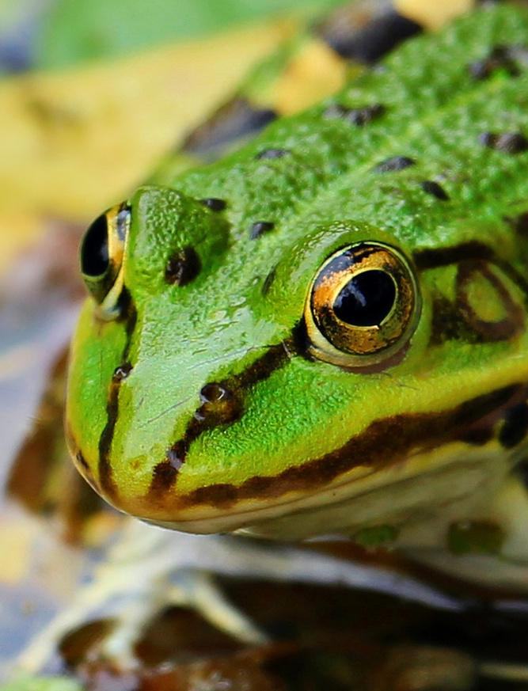
YOLO – You Look Only Once
Yolo is an algorithm which can detect objects really fast. It uses one of the best neural network architectures to produce high accuracy and overall processing speed, which is the main reason for its popularity.

Slide 6
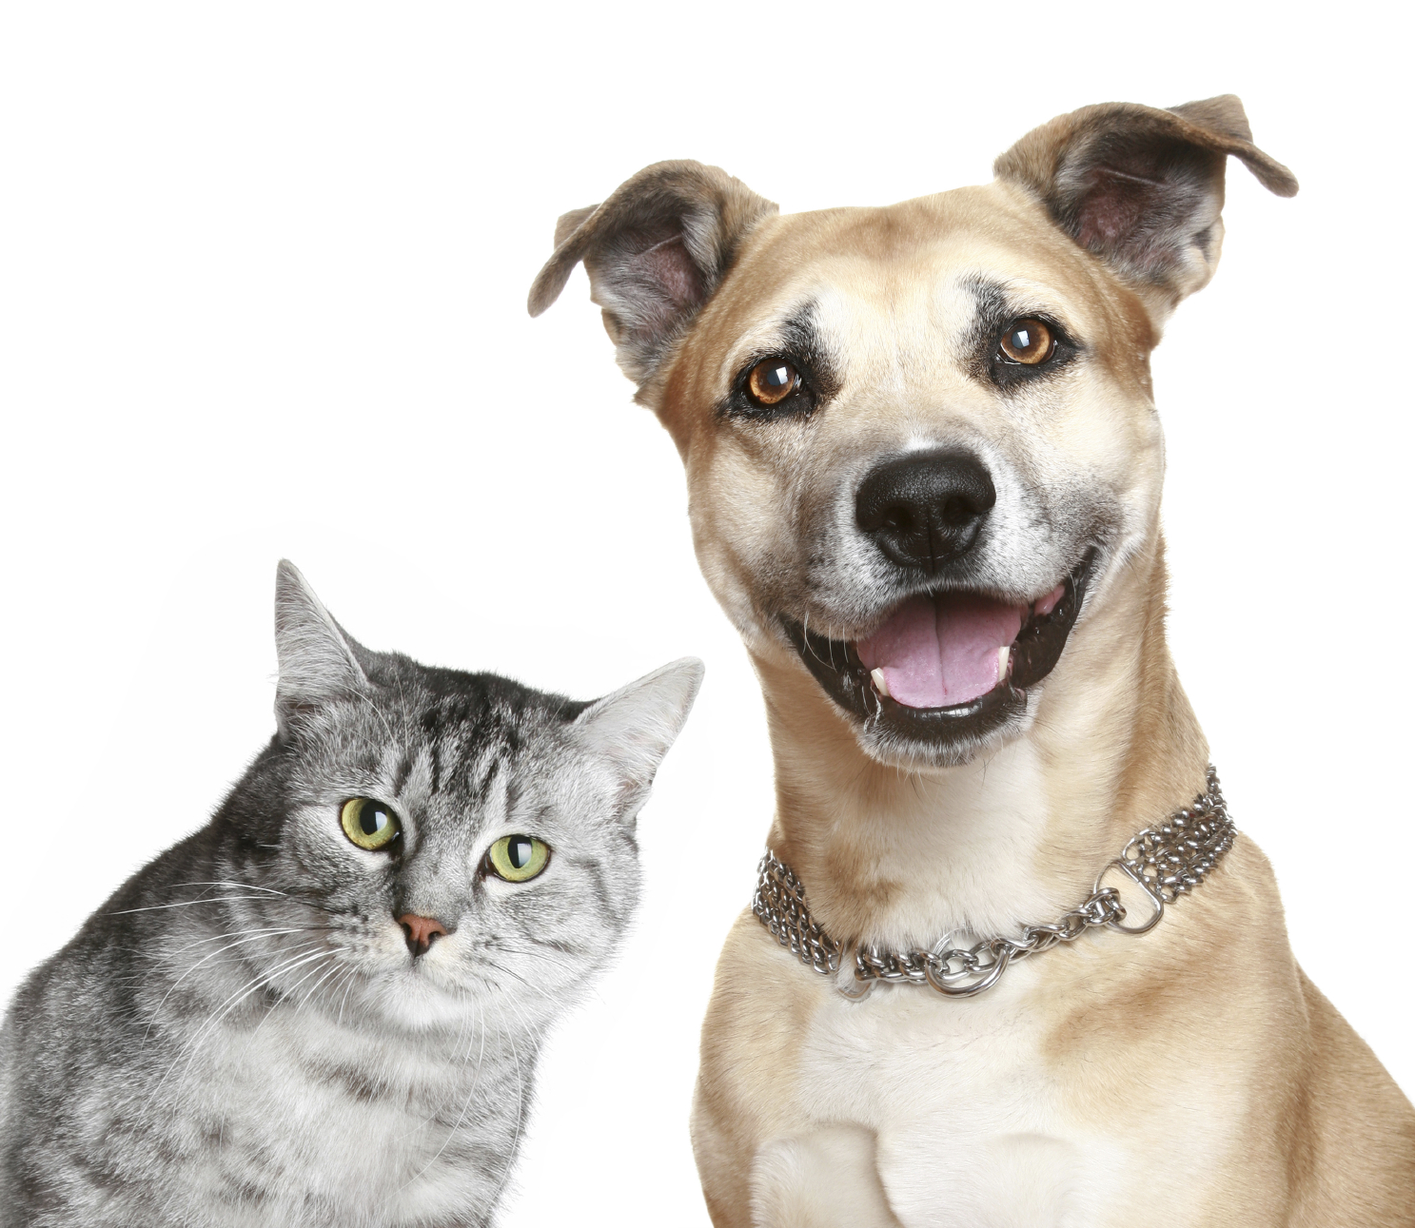
How YOLO Works?
Segmentation
Dividing image in grid of small sections
Detection
Identifying the objects in the small grid.
Traning & Testing
Representing each cell with an array

Slide 7
How YOLO Works?
Segmentation
The first step that YOLO does is dividing the image into a grid. For example, a 3×3 grid
Detection
With the existence of a grid, it’s possible to detect one object per grid cell instead of one object per image. For each grid cell, we can encode a vector that will describe the cell.
Training & Testing
Using this data set, we are able to create a training and test set and train the convolutional network. YOLO is able to predict all objects in one forward pass and that is the reason for its full name “You Only Look Once”

Slide 8
Segmentation
The first step that YOLO does is dividing the image into a grid. For example, a 3×3 grid
0 ? ? ? ? ? ?
Detection
With the existence of a grid, it’s possible to detect one object per grid cell instead of one object per image. For each grid cell, we can encode a vector that will describe the cell.
1 0.01 0.5 1.9 2.5 1 0
1 0.95 0.05 1.5 1.5 0 1
P_{c} B_{x} B_{y} B_{w} B_{h} C₁ C₂
Training & Testing
Using this data set, we are able to create a training and test set and train the convolutional network. YOLO is able to predict all objects in one forward pass and that is the reason for its full name “You Only Look Once”

Slide 9
Segmentation
The first step that YOLO does is dividing the image into a grid. For example, a 3×3 grid
Detection
With the existence of a grid, it’s possible to detect one object per grid cell instead of one object per image. For each grid cell, we can encode a vector that will describe the cell.
Training & Testing
Using this data set, we are able to create a training and test set and train the convolutional network. YOLO is able to predict all objects in one forward pass and that is the reason for its full name “You Only Look Once”
Dog
Cat

Slide 10
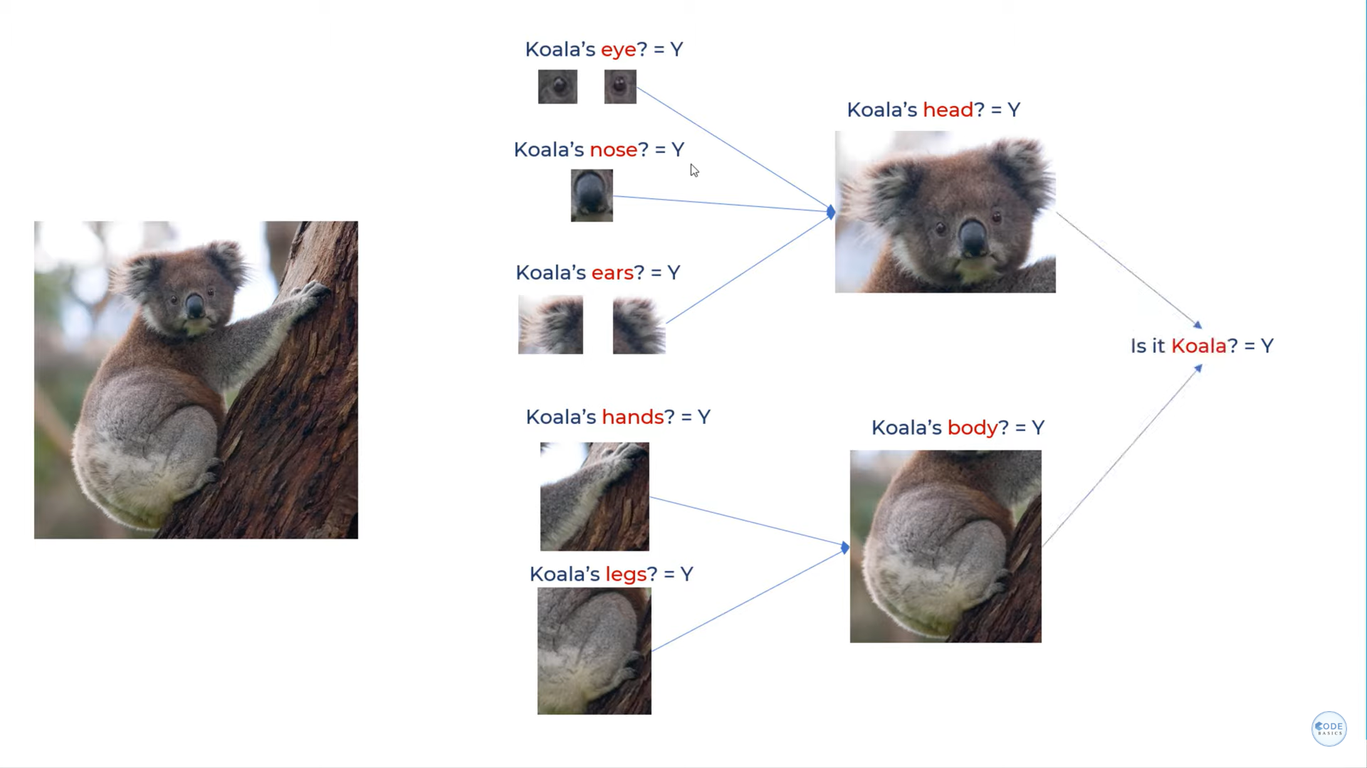
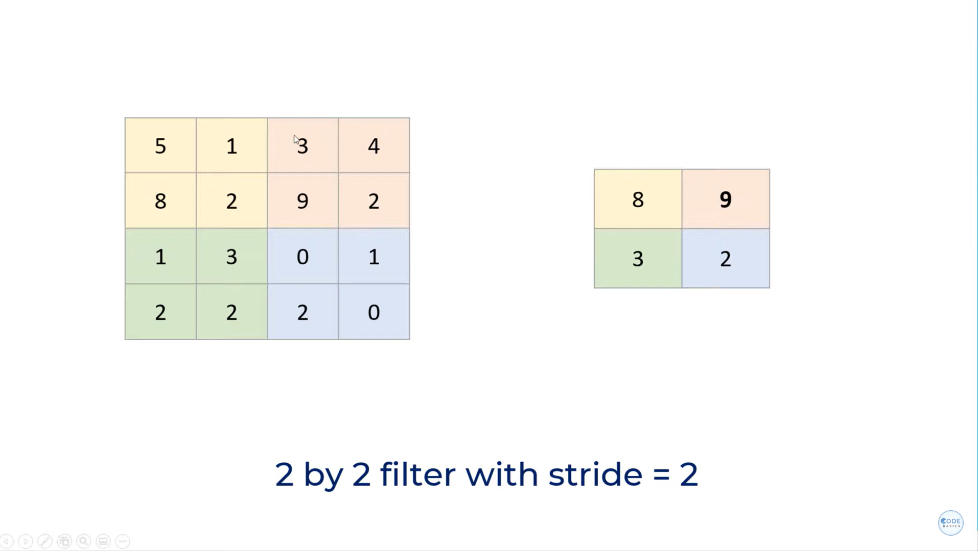
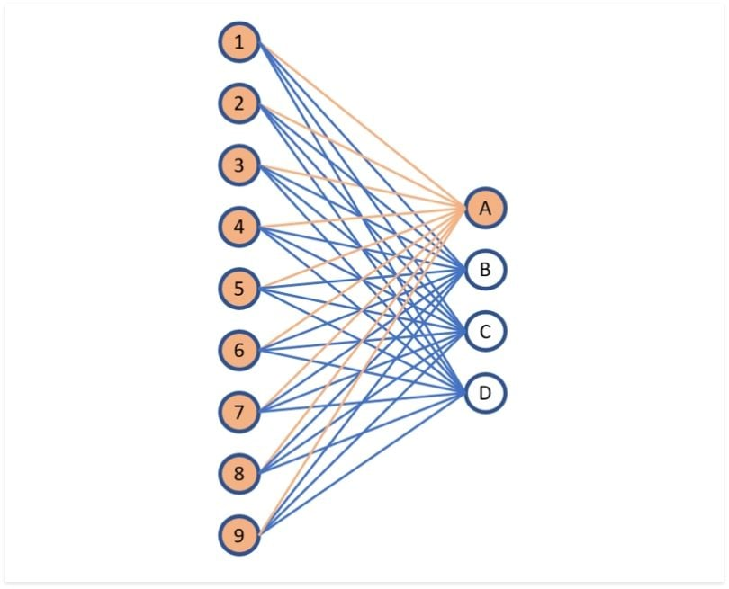
CNN – Convolutional Neural Network
A Convolutional Neural Network (CNN) is a type of deep learning algorithm that is particularly well-suited for image recognition and processing tasks. It is made up of multiple layers, including convolutional layers, pooling layers, and fully connected layers.
Convolutional layer
Pooling layer
Connected layer
It contains a set of filters parameters of which are to be learned throughout the training
The main purpose of pooling is to reduce the size of feature maps, which in turn makes computation faster
Consists of the weights and biases along with the neurons and is used to connect the neurons between two different layers

Slide 11
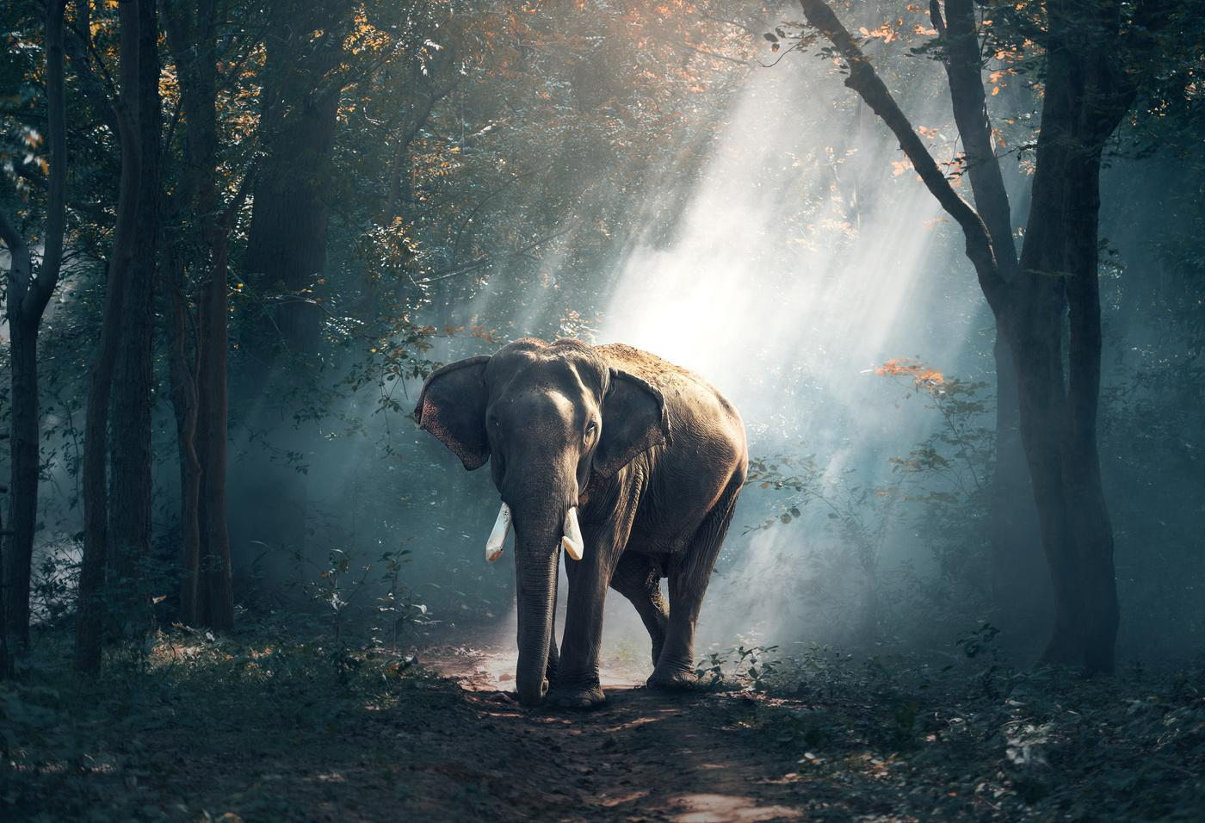
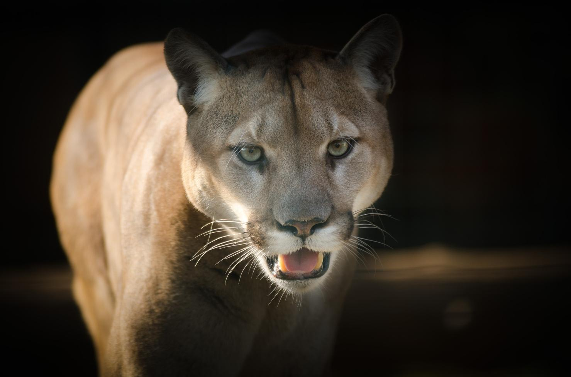
Creating Custom Dataset
Dataset Used
Animals Detection Images Dataset was downloaded from Kaggle for training and testing. The dataset contains 2377 images of each animal from which 75% of images were used for training and remaining for testing.

Slide 12
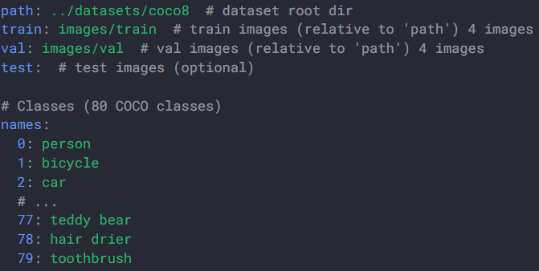
Ultralytics YOLO format
The Ultralytics YOLO format is a dataset configuration format that allows you to define the dataset root directory, the relative paths to training/validation/testing image directories or *.txt files containing image paths, and a dictionary of class names. Here is an example:

Slide 13
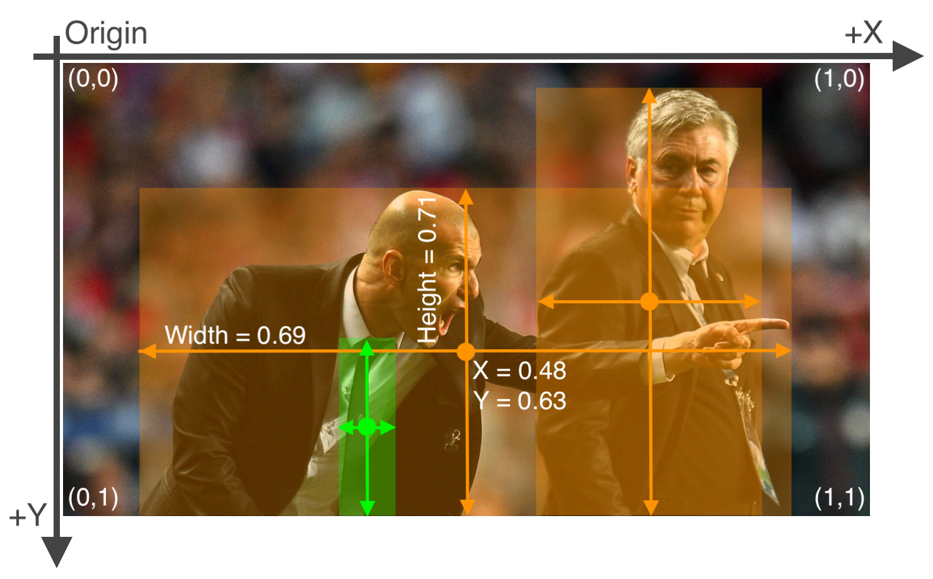
Ultralytics YOLO format
Labels for this format should be exported to YOLO format with one *.txt file per image. If there are no objects in an image, no *.txt file is required. The *.txt file should be formatted with one row per object in class x_center y_center width height format. Box coordinates must be in normalized xywh format (from 0 to 1). If your boxes are in pixels, you should divide x_center and width by image width, and y_center and height by image height. Class numbers should be zero-indexed (start with 0).

Slide 14
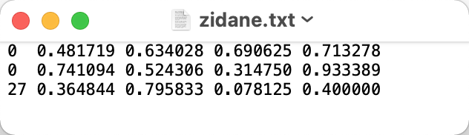
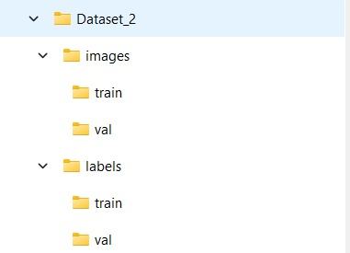
Ultralytics YOLO format
The label file corresponding to the above image contains 2 persons (class 0) and a tie (class 27):
When using the Ultralytics YOLO format, organize your training and validation images and labels as shown in the example below.

Slide 15
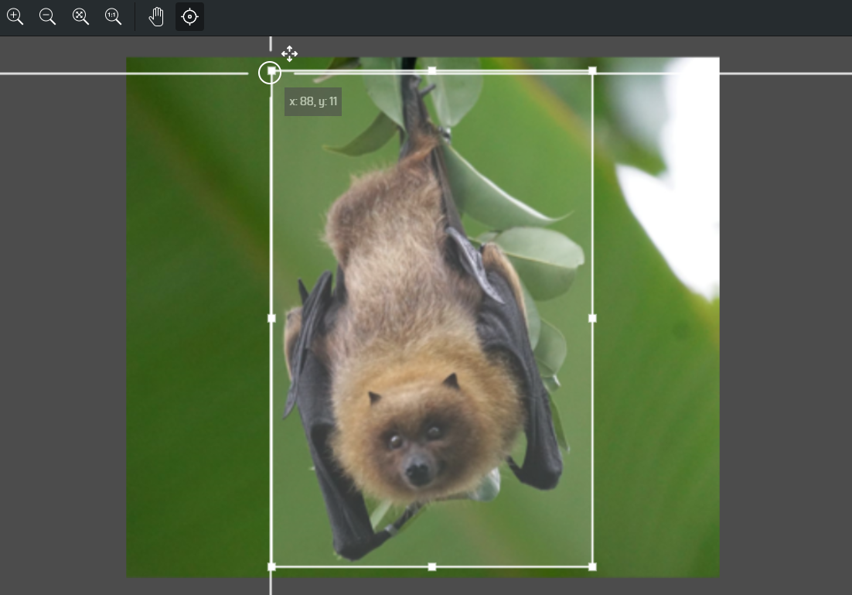
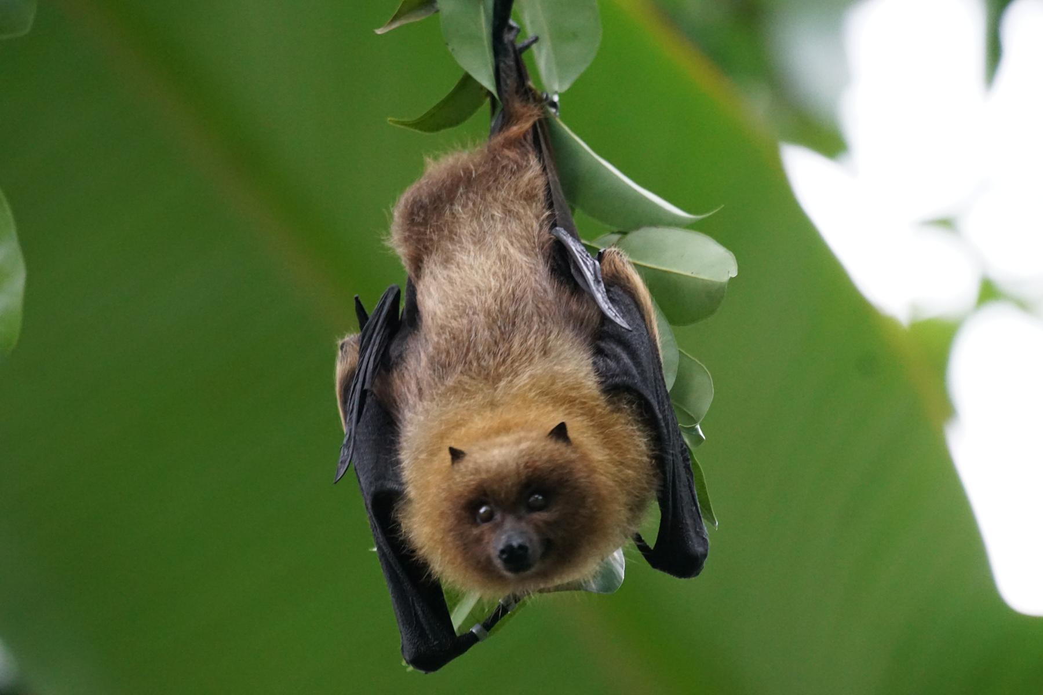
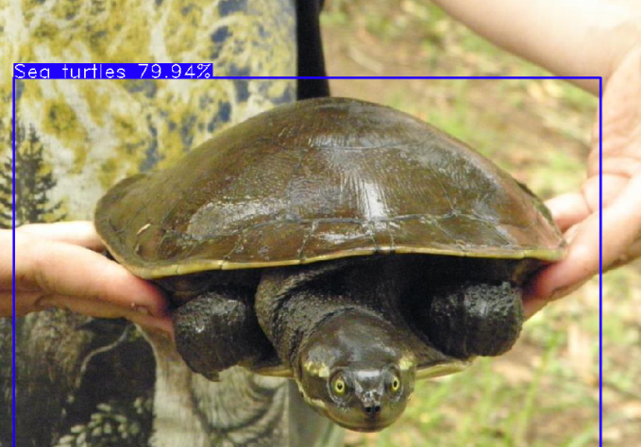
Creating Custom Dataset
Creating dataset from clicked photos
Clicked photos can be uploaded to a website makesence.ai to annotate and generate labels for the images. These generated data can now be used for training and testing of the model
Downloading custom labled dataset
We can download custom labled images using the toolkit OID_v4 toolkit which is an open-source project present on github.

Slide 16
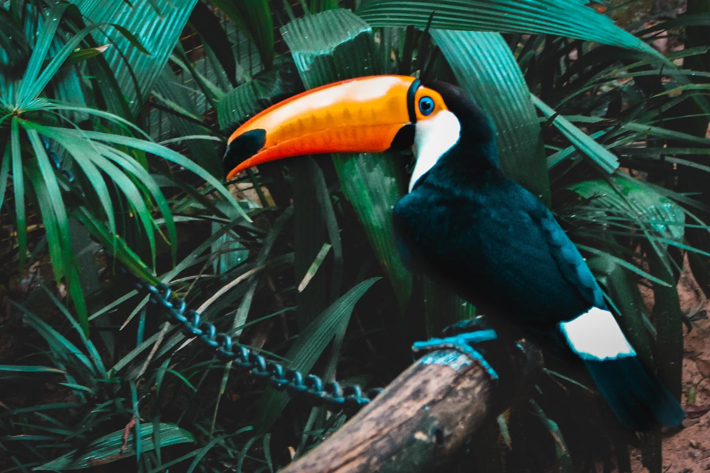
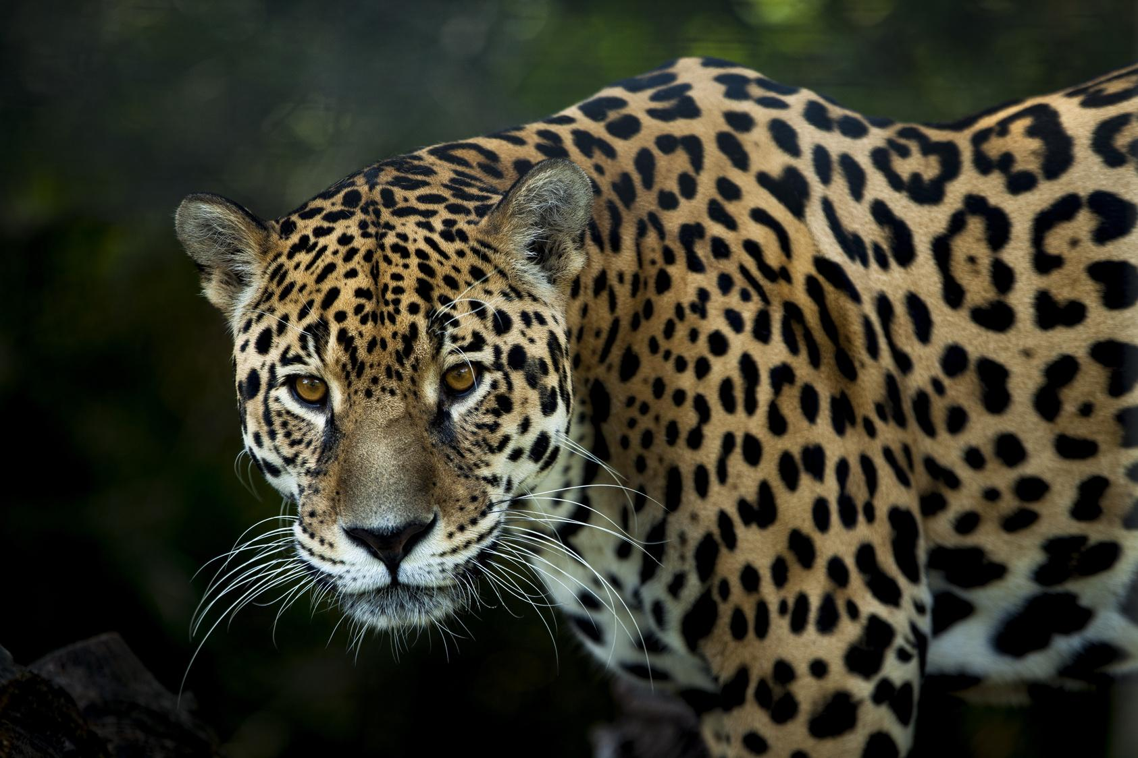
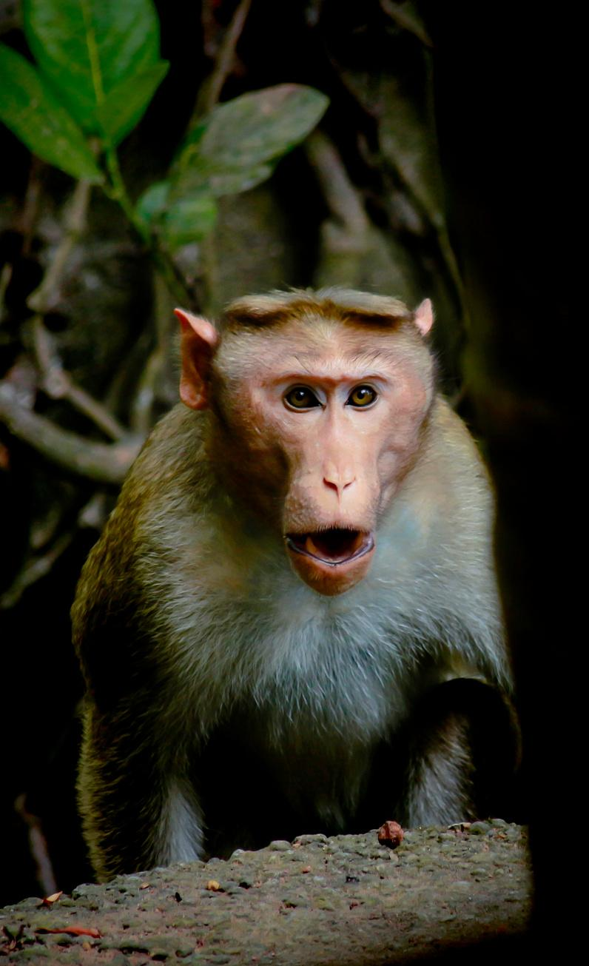
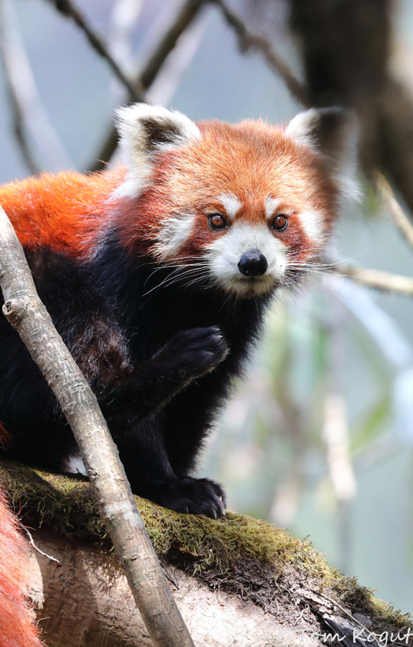
Classification
Vulnerable
Endangered
Least Concern
Near Threatened
Fragile lives teetering on edge, desperate for our shield
Facing vanishing future, fragile lives need urgent shelter
Thriving and stable, needs monitoring, not immediate protection
Nearing extinction's edge, yet hope remains - proactive care now vital

Slide 17
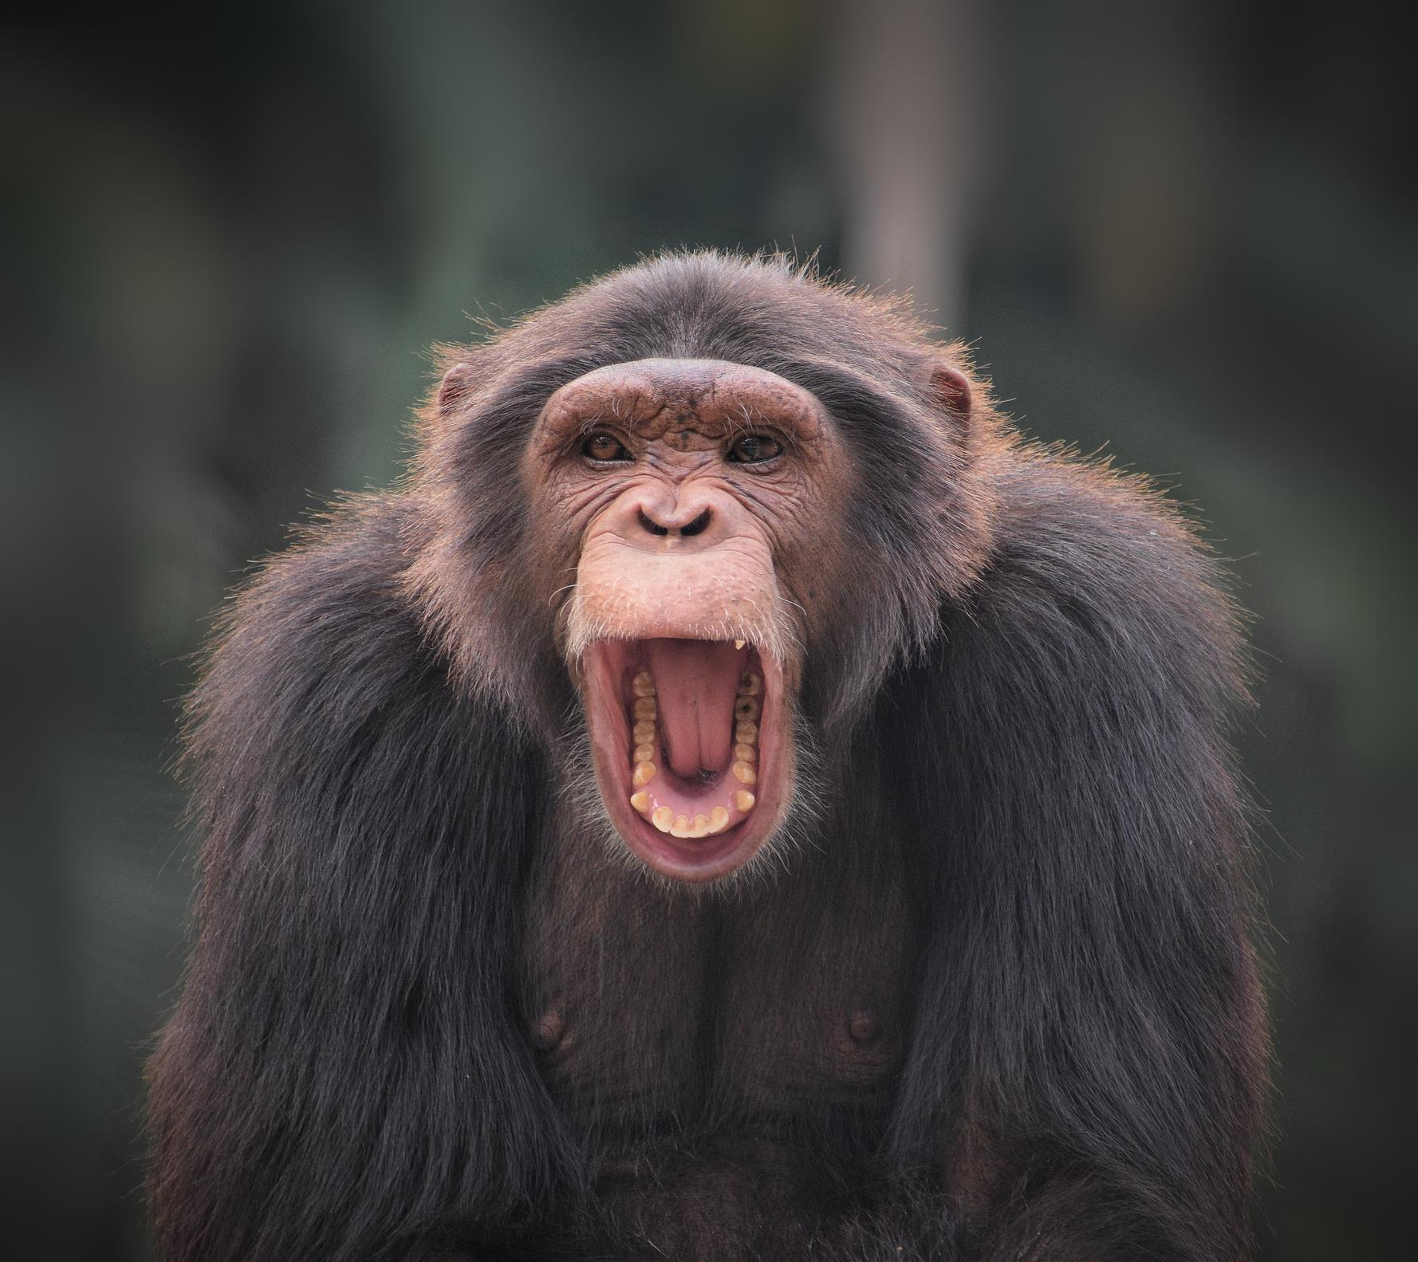
Conclusion
In concluding the 'AI Safari Sentinel' project, we celebrate a milestone in the realm of wildlife monitoring and conservation. The successful integration of YOLOv8, coupled with strategic animal selection and meticulous model training, has yielded a system with a commendable 98% accuracy rate. This achievement underscores the project's efficacy in identifying, classifying, and marking animals in videos, paving the way for enhanced ecological understanding and conservation efforts. The utilization of Google Collab has not only streamlined the development process but has also facilitated collaborative advancements in the field. Acknowledging current limitations and envisioning future expansions, 'AI Safari Sentinel' stands as a testament to the potential of artificial intelligence in safeguarding our planet's biodiversity. This project not only exemplifies technological excellence but also symbolizes a dedicated step towards a more informed and proactive approach to wildlife preservation.

